Slide 1
Bank Functions by Using Interface
Java Project
Made by Onkar Samel

Slide 2
Interface
Abstract Class (methods doesn’t has body)
group the related methods with empty bodies
100% Abstraction is possible
To be Continue...

Slide 3
Interface
Interface cann’t be instantiated.
By default all methods are abstract & public
doesn’t contains any constructors
supports only static & final variables
only impemented by class not extended
can extend multiple interfaces
To be Continue...

Slide 4
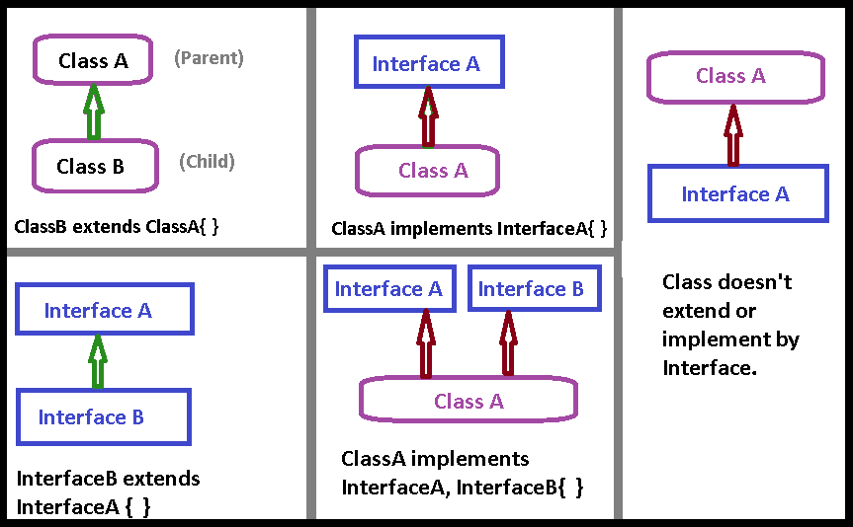
Relation between Interfaces & Classes
To be Continue...

Slide 5
Bank Interfaces & Classes

Slide 6
Thank You!

